Slide 1
The semantics of events
Nick Riches
Tense
What is tense? A future tense?
The semantics of events
Lexical Aspect
Inherent temporal properties of events
States versus non-states
Activities versus events
Accomplishments versus achievements
Lexical Aspect Table Summary of tests Multiple lexical aspects
Nick Riches
Newcastle University
Grammatical aspect
What is grammatical aspect?
January 29, 2020
Tense is not aspect
Tense & Aspect combinations
Pres. tense combs.
Prog. asp. combs.
Tense/aspect and
SLT practice
Homework
Bibliography
1 / 38

Slide 2
The semantics of events
Nick Riches
Tense
Lexical Aspect
Tense
What is tense? A future tense?
Lexical Aspect
Inherent temporal properties of events
States versus non-states
Activities versus events
Accomplishments versus achievements
Lexical Aspect Table Summary of tests Multiple lexical aspects
Grammatical aspect
Tense is not aspect
Combinations of tense, grammatical and lexical aspect
Grammatical aspect
What is grammatical aspect?
Tense/aspect and SLT practice
Homework
Tense is not aspect
Tense & Aspect combinations
Pres. tense combs.
Bibliography
Prog. asp. combs.
Tense/aspect and
SLT practice
Homework
Bibliography
1 / 38

Slide 3


What is tense?
The semantics of events
Nick Riches
“Tense” refers to when an action took place in relation to the time of speaking, e.g.
Tense
What is tense? A future tense?
Lexical Aspect
Inherent temporal properties of events
States versus non-states
Activities versus events
Accomplishments versus achievements
Lexical Aspect Table Summary of tests Multiple lexical aspects
I bought some apples PAST TENSE
Grammatical aspect
What is grammatical aspect?
TIME
Tense is not aspect
Sabrine is happy
PRESENT TENSE
Tense & Aspect combinations
Pres. tense combs.
Prog. asp. combs.
Tense/aspect and
SLT practice
Homework
Bibliography
2 / 38

Slide 4
A future tense?
The semantics of events
Future tense?
Nick Riches
will
Tense
What is tense? A future tense?
1. I {
am going to
help you to carry that shopping.
{
2. I think England
will
win the match on Tuesday.
Lexical Aspect
Inherent temporal properties of events
States versus non-states
Activities versus events
Accomplishments versus achievements
Lexical Aspect Table Summary of tests Multiple lexical aspects
are going to
3. England are winning 3-nil with only five minutes of extra
{
time. They
will
win.
are going to
f
is going to leave is leaving
leaves
4. The train
at 6.15.
Grammatical aspect
What is grammatical aspect?
f
1
m going to go
¹m going will go
Tense is not aspect
5. Next year,
on holiday somewhere hot.
Tense & Aspect combinations
Pres. tense combs. Prog. asp. combs.
f
1
m going to have ¹m having will have
6. Tonight I
dinner with some friends.
Tense/aspect and
SLT practice
Homework
Bibliography
3 / 38

Slide 5
A future tense?
The semantics of events
Future tense?
Nick Riches
will
Tense
What is tense? A future tense?
1. I {
?am going to
help you to carry that shopping. OFFER
{
2. I think England
will
win the match on Tuesday.
Lexical Aspect
Inherent temporal properties of events
States versus non-states
Activities versus events
Accomplishments versus achievements
Lexical Aspect Table Summary of tests Multiple lexical aspects
are going to
3. England are winning 3-nil with only five minutes of extra
{
time. They
will
win.
are going to
f
is going to leave is leaving
leaves
4. The train
at 6.15.
Grammatical aspect
What is grammatical aspect?
f
1
m going to go
¹m going will go
Tense is not aspect
5. Next year,
on holiday somewhere hot.
Tense & Aspect combinations
Pres. tense combs. Prog. asp. combs.
f
1
m going to have ¹m having will have
6. Tonight I
dinner with some friends.
Tense/aspect and
SLT practice
Homework
Bibliography
3 / 38

Slide 6
A future tense?
The semantics of events
Future tense?
Nick Riches
will
Tense
What is tense? A future tense?
1. I {
?am going to
help you to carry that shopping. OFFER
{
2. I think England
✓✓will
win the match on Tuesday.
Lexical Aspect
Inherent temporal properties of events
States versus non-states
Activities versus events
Accomplishments versus achievements
Lexical Aspect Table Summary of tests Multiple lexical aspects
are going to
PREDICTION
3. England are winning 3-nil with only five minutes of extra
{
time. They
will
win.
are going to
f
is going to leave is leaving
leaves
4. The train
at 6.15.
Grammatical aspect
What is grammatical aspect?
f
1
m going to go
¹m going will go
Tense is not aspect
5. Next year,
on holiday somewhere hot.
Tense & Aspect combinations
Pres. tense combs. Prog. asp. combs.
f
1
m going to have ¹m having will have
6. Tonight I
dinner with some friends.
Tense/aspect and
SLT practice
Homework
Bibliography
3 / 38

Slide 7
A future tense?
The semantics of events
Future tense?
Nick Riches
will
Tense
What is tense? A future tense?
1. I {
?am going to
help you to carry that shopping. OFFER
{
2. I think England
✓✓will
win the match on Tuesday.
Lexical Aspect
Inherent temporal properties of events
States versus non-states
Activities versus events
Accomplishments versus achievements
Lexical Aspect Table Summary of tests Multiple lexical aspects
are going to
PREDICTION
3. England are winning 3-nil with only five minutes of extra
{
time. They
??will
win.
are going to
PREDICTION BASED ON STRONG EVIDENCE
f
is going to leave is leaving
leaves
4. The train
at 6.15.
Grammatical aspect
What is grammatical aspect?
f
1
m going to go
¹m going will go
Tense is not aspect
5. Next year,
on holiday somewhere hot.
Tense & Aspect combinations
Pres. tense combs. Prog. asp. combs.
f
1
m going to have ¹m having will have
6. Tonight I
dinner with some friends.
Tense/aspect and
SLT practice
Homework
Bibliography
3 / 38

Slide 8
A future tense?
The semantics of events
Future tense?
Nick Riches
will
Tense
What is tense? A future tense?
1. I {
?am going to
help you to carry that shopping. OFFER
{
2. I think England
✓✓will
win the match on Tuesday.
Lexical Aspect
Inherent temporal properties of events
States versus non-states
Activities versus events
Accomplishments versus achievements
Lexical Aspect Table Summary of tests Multiple lexical aspects
are going to
PREDICTION
3. England are winning 3-nil with only five minutes of extra
{
time. They
??will
win.
are going to
PREDICTION BASED ON STRONG EVIDENCE
f
?is going to leave
4. The train ?is leaving
at 6.15.
Grammatical aspect
What is grammatical aspect?
✓✓leaves
TIMETABLE FUTURE
f
1
m going to go
¹m going will go
Tense is not aspect
5. Next year,
on holiday somewhere hot.
Tense & Aspect combinations
Pres. tense combs. Prog. asp. combs.
f
1
m going to have ¹m having will have
6. Tonight I
dinner with some friends.
Tense/aspect and
SLT practice
Homework
Bibliography
3 / 38

Slide 9
A future tense?
The semantics of events
Future tense?
Nick Riches
will
Tense
What is tense? A future tense?
1. I {
?am going to
help you to carry that shopping. OFFER
{
2. I think England
✓✓will
win the match on Tuesday.
Lexical Aspect
Inherent temporal properties of events
States versus non-states
Activities versus events
Accomplishments versus achievements
Lexical Aspect Table Summary of tests Multiple lexical aspects
are going to
PREDICTION
3. England are winning 3-nil with only five minutes of extra
{
time. They
??will
win.
are going to
PREDICTION BASED ON STRONG EVIDENCE
f
?is going to leave
4. The train ?is leaving
at 6.15.
Grammatical aspect
What is grammatical aspect?
✓✓leaves
TIMETABLE FUTURE
f
1
✓✓ m going to go
Tense is not aspect
5. Next year,
¹m going
will go
on holiday somewhere hot.
Tense & Aspect combinations
Pres. tense combs. Prog. asp. combs.
PLAN
f
1
m going to have ¹m having will have
6. Tonight I
dinner with some friends.
Tense/aspect and
SLT practice
Homework
Bibliography
3 / 38

Slide 10
A future tense?
The semantics of events
Future tense?
Nick Riches
will
Tense
What is tense? A future tense?
1. I {
?am going to
help you to carry that shopping. OFFER
{
2. I think England
✓✓will
win the match on Tuesday.
Lexical Aspect
Inherent temporal properties of events
States versus non-states
Activities versus events
Accomplishments versus achievements
Lexical Aspect Table Summary of tests Multiple lexical aspects
are going to
PREDICTION
3. England are winning 3-nil with only five minutes of extra
{
time. They
??will
win.
are going to
PREDICTION BASED ON STRONG EVIDENCE
f
?is going to leave
4. The train ?is leaving
at 6.15.
Grammatical aspect
What is grammatical aspect?
✓✓leaves
TIMETABLE FUTURE
f
1
✓✓ m going to go
Tense is not aspect
5. Next year,
¹m going
will go
on holiday somewhere hot.
Tense & Aspect combinations
Pres. tense combs. Prog. asp. combs.
PLAN
f_{✓1}
m going to have
6. Tonight I
✓✓¹m having
dinner with some friends.
Tense/aspect and SLT practice
?will have
Homework
ARRANGEMENT
Bibliography
3 / 38

Slide 11
The semantics of events
Nick Riches
Tense
Lexical Aspect
Tense
What is tense? A future tense?
Lexical Aspect
Inherent temporal properties of events
States versus non-states
Activities versus events
Accomplishments versus achievements
Lexical Aspect Table Summary of tests Multiple lexical aspects
Grammatical aspect
Tense is not aspect
Combinations of tense, grammatical and lexical aspect
Grammatical aspect
What is grammatical aspect?
Tense/aspect and SLT practice
Homework
Tense is not aspect
Tense & Aspect combinations
Pres. tense combs.
Bibliography
Prog. asp. combs.
Tense/aspect and
SLT practice
Homework
Bibliography
3 / 38

Slide 12
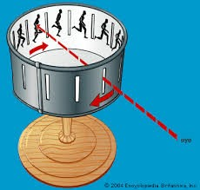
Inherent temporal properties of events
The semantics of events
Nick Riches
Tense
What is tense? A future tense?
Lexical Aspect
Inherent temporal properties of events
States versus non-states
Activities versus events
Accomplishments versus achievements
Lexical Aspect Table Summary of tests Multiple lexical aspects
Grammatical aspect
What is grammatical aspect?
Tense is not aspect
Tense & Aspect combinations
Pres. tense combs.
Prog. asp. combs.
Tense/aspect and
SLT practice
Homework
Bibliography
4 / 38

Slide 13
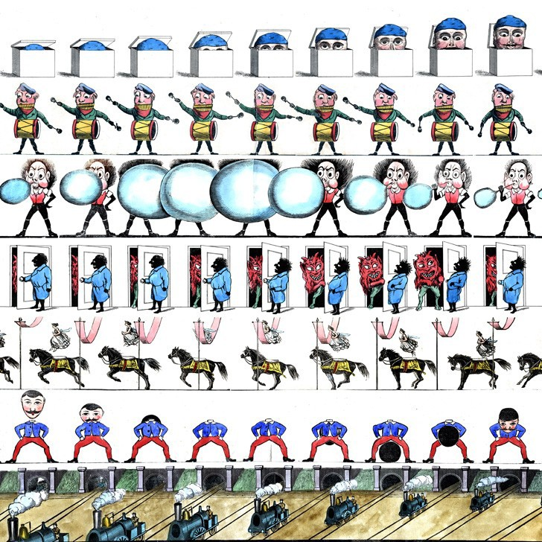
Inherent temporal properties of events
The semantics of events
Nick Riches
Tense
What is tense? A future tense?
Lexical Aspect
Inherent temporal properties of events
States versus non-states
Activities versus events
Accomplishments versus achievements
Lexical Aspect Table Summary of tests Multiple lexical aspects
Grammatical aspect
What is grammatical aspect?
Tense is not aspect
Tense & Aspect combinations
Youtube Clip
Pres. tense combs.
Prog. asp. combs.
Tense/aspect and
SLT practice
Homework
Bibliography
5 / 38

Slide 14
Inherent temporal properties of events
The semantics of events
Nick Riches
Tense
What is tense? A future tense?
Which of the following verbs would make a good zoetrope?
Lexical Aspect
Inherent temporal properties of events
States versus non-states
Activities versus events
Accomplishments versus achievements
Lexical Aspect Table Summary of tests Multiple lexical aspects
swim
crash
laugh
dive
pop
dance
exist
Grammatical aspect
What is grammatical aspect?
Tense is not aspect
Tense & Aspect combinations
Pres. tense combs.
Prog. asp. combs.
Tense/aspect and
SLT practice
Homework
Bibliography
6 / 38

Slide 15
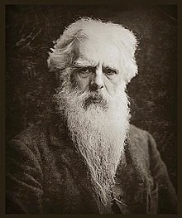
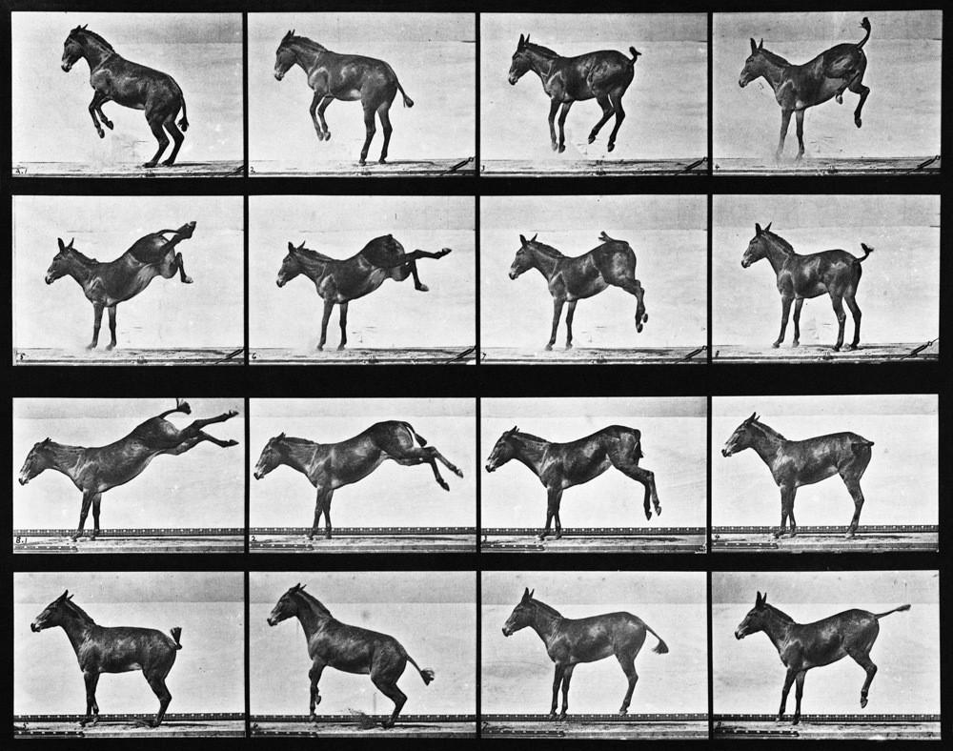
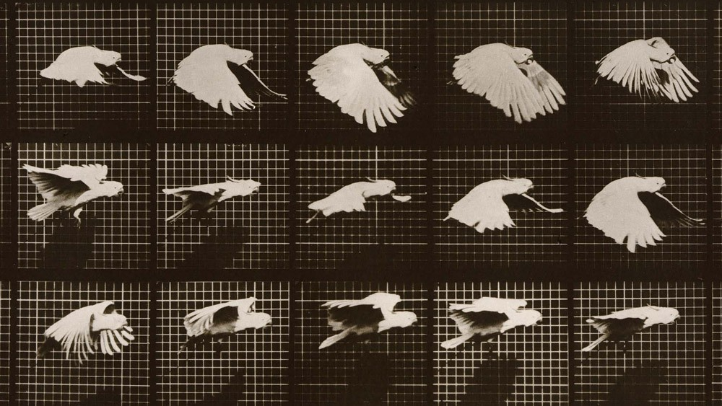
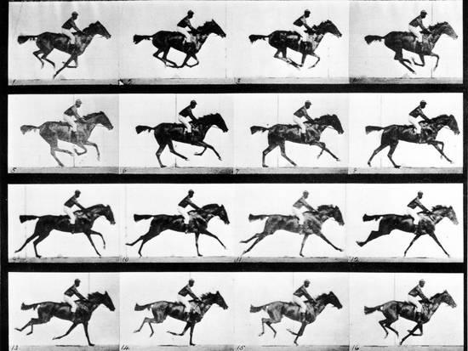
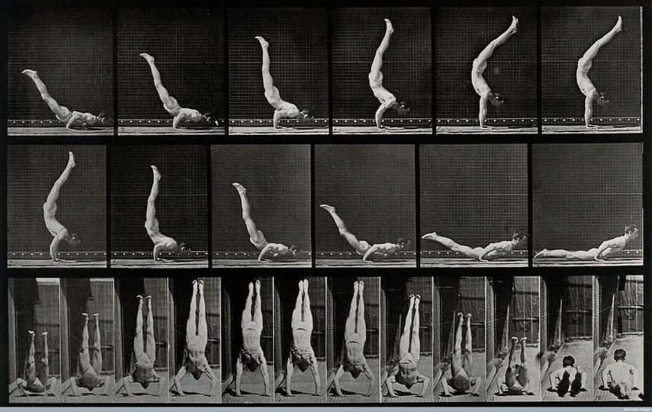
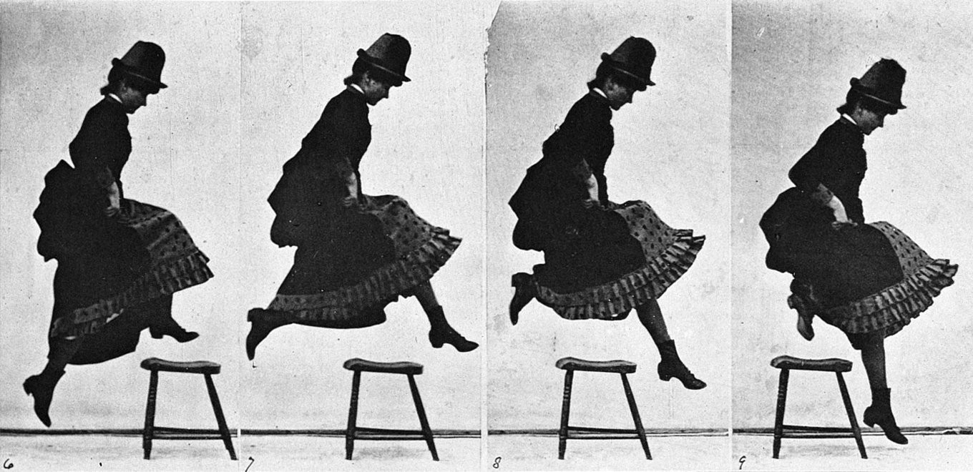
Inherent temporal properties of events
The semantics of events
Nick Riches
Eadweard Muybridge (1830 - 1904)
Tense
What is tense? A future tense?
Lexical Aspect
Inherent temporal properties of events
States versus non-states
Activities versus events
Accomplishments versus achievements
Lexical Aspect Table Summary of tests Multiple lexical aspects
Grammatical aspect
What is grammatical aspect?
Tense is not aspect Tense & Aspect
combinations
Pres. tense combs. Prog. asp. combs.
Tense/aspect and
SLT practice
Homework
Bibliography
7 / 38

Slide 16
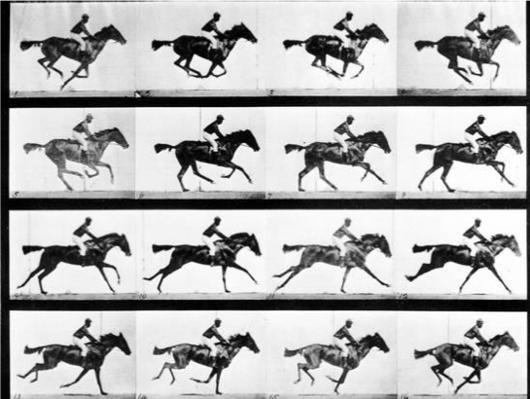
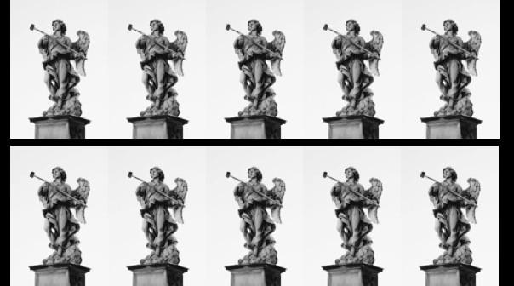
Inherent temporal properties of events
The semantics of events
Nick Riches
Tense
What is tense? A future tense?
‘Internal structure’
Lexical Aspect
Inherent temporal properties of events
States versus non-states
Activities versus events
Accomplishments versus achievements
Lexical Aspect Table Summary of tests Multiple lexical aspects
‘Run’
‘Exist’
Grammatical aspect
What is grammatical aspect?
Tense is not aspect
Tense & Aspect combinations
Pres. tense combs. Prog. asp. combs.
Tense/aspect and SLT practice
Homework Bibliography
8 / 38

Slide 17
(a) States versus non-states
The semantics of events
Nick Riches
Tense
What is tense? A future tense?
Lexical Aspect
Inherent temporal properties of events
States versus non-states
Activities versus events
Accomplishments versus achievements
Lexical Aspect Table Summary of tests Multiple lexical aspects
Existing verbs, be, live, exist,
Experiencer-theme verbs, e.g. like, love, hate
Mental State verbs, e.g. believe, know, hope.
Grammatical aspect
What is grammatical aspect?
Tense is not aspect
Tense & Aspect combinations
Pres. tense combs.
Prog. asp. combs.
Tense/aspect and
SLT practice
Homework
Bibliography
9 / 38

Slide 18
(a) States versus non-states
The semantics of events
Nick Riches
Tense
What is tense? A future tense?
Tests. . .
Lexical Aspect
Inherent temporal properties of events
States versus non-states
Activities versus events
Accomplishments versus achievements
Lexical Aspect Table Summary of tests Multiple lexical aspects
States are difficult to define
State verbs sound odd in the progressive (-ing form),
e.g. ??she is existing, ??she is liking the food, ??I am believing in fairies. This is because the progressive is used with verbs with INTERNAL STRUCTURE.
3. State verbs sound odd as reponses to the question what happened?, e.g. Q. What happened? ???A. She liked the food
Grammatical aspect
What is grammatical aspect?
Tense is not aspect
Tense & Aspect combinations
Pres. tense combs.
Prog. asp. combs.
Tense/aspect and
SLT practice
Homework
Bibliography
10 / 38

Slide 19
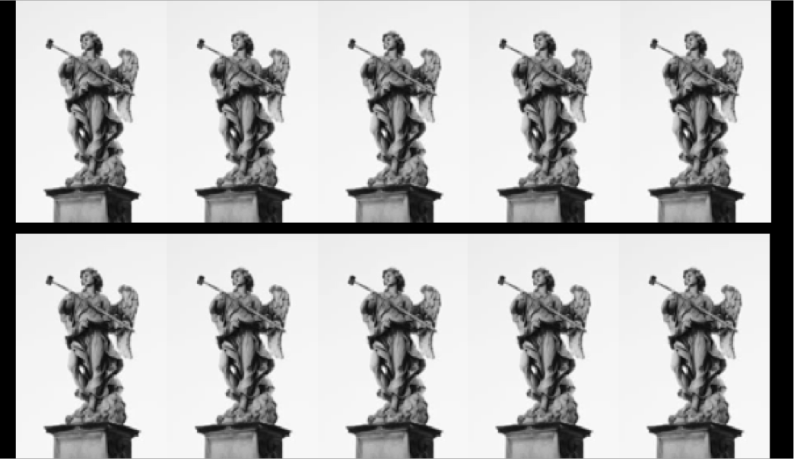
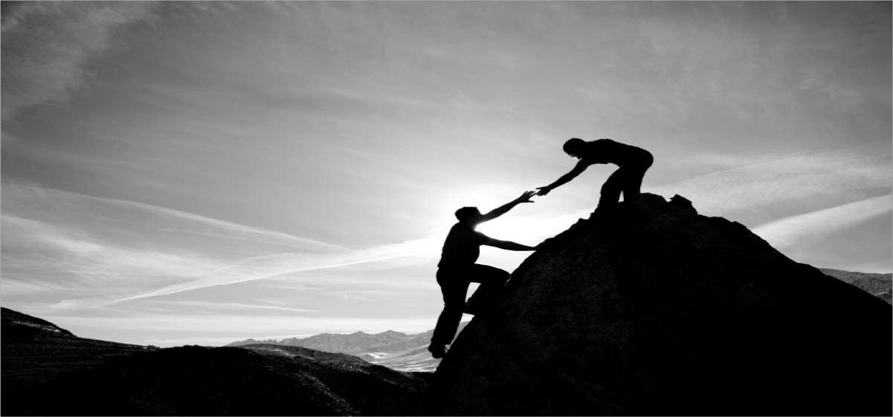
(b) Activities versus events
The semantics of events
Nick Riches
Tense
What is tense? A future tense?
Lexical aspect
Lexical Aspect
Inherent temporal properties of events
States versus non-states
Activities versus events
Accomplishments versus achievements
Lexical Aspect Table Summary of tests Multiple lexical aspects
State
Non-state
Progressive test (for INTERNAL STRUCTURE)
“for” test (for TELICITY)
Event
Grammatical aspect
What is grammatical aspect?
Activity
“stop” test
Accomplishment Achievement
Tense is not aspect
Tense & Aspect
combinations
Pres. tense combs. Prog. asp. combs.
Tense/aspect and
SLT practice
Homework
Bibliography
11 / 38

Slide 20
(b) Activities versus events
The semantics of events
Nick Riches
Tense
What is tense? A future tense?
Lexical Aspect
Inherent temporal properties of events
States versus non-states
Activities versus events
Accomplishments versus achievements
Lexical Aspect Table Summary of tests Multiple lexical aspects
Activities do not have a natural end point (they are “atelic”). Events have a natural end point (they are “telic”).
Examples of activities are run, walk, wash, work
Examples of events are break, collapse, crash, fall
Grammatical aspect
What is grammatical aspect?
Tense is not aspect
Tense & Aspect combinations
Pres. tense combs. Prog. asp. combs.
Tense/aspect and SLT practice
Homework Bibliography
12 / 38

Slide 21
(b) Activities versus events
The semantics of events
Nick Riches
Tense
What is tense? A future tense?
Lexical Aspect
Inherent temporal properties of events
States versus non-states
Activities versus events
Accomplishments versus achievements
Lexical Aspect Table Summary of tests Multiple lexical aspects
Tests. . .
Activities sound good when used with time expressions which imply an incomplete activity e.g. I’ve been walking for an hour (and I may continue to walk for another hour).
Events sound odd when used with such time expressions, e.g
It collapsed for an hour.
Grammatical aspect
What is grammatical aspect?
Tense is not aspect
Tense & Aspect combinations
Pres. tense combs. Prog. asp. combs.
Tense/aspect and SLT practice
Homework Bibliography
13 / 38

Slide 22
(b) Activities versus events
The semantics of events
Nick Riches
Tense
What is tense? A future tense?
Lexical Aspect
Inherent temporal properties of events
States versus non-states
Activities versus events
Accomplishments versus achievements
Lexical Aspect Table Summary of tests Multiple lexical aspects
Events sound good with time expressions which imply a complete activity, e.g. The bridge collapsed in five seconds.
Activities do not sound good with such time expressions, e.g.
He walked in five minutes
Grammatical aspect
What is grammatical aspect?
Tense is not aspect
Tense & Aspect combinations
Pres. tense combs. Prog. asp. combs.
Tense/aspect and SLT practice
Homework Bibliography
14 / 38

Slide 23
(b) Activities versus events
The semantics of events
Nick Riches
Eadweard Muybridge (1830 - 1904)
Tense
What is tense? A future tense?
Lexical aspect
Lexical Aspect
Inherent temporal properties of events
States versus non-states
Activities versus events
Accomplishments versus achievements
Lexical Aspect Table Summary of tests Multiple lexical aspects
State
Non-state
Progressive test (for INTERNAL STRUCTURE)
Event
Grammatical aspect
What is grammatical aspect?
“for” test (for TELICITY)
Activity
“stop” test
Accomplishment Achievement
Tense is not aspect
Tense & Aspect
combinations
Pres. tense combs. Prog. asp. combs.
Tense/aspect and
SLT practice
Homework
Bibliography
15 / 38

Slide 24
(c) Accomplishments versus achievements
The semantics of events
Nick Riches
Eadweard Muybridge (1830 - 1904)
Tense
What is tense? A future tense?
Lexical aspect
Lexical Aspect
Inherent temporal properties of events
States versus non-states
Activities versus events
Accomplishments versus achievements
Lexical Aspect Table Summary of tests Multiple lexical aspects
State
Non-state
Progressive test (for INTERNAL STRUCTURE)
Event
Grammatical aspect
What is grammatical aspect?
“for” test (for TELICITY)
Activity
“stop” test
Tense is not aspect
Accomplishment
Achievement
Tense & Aspect
combinations
Pres. tense combs. Prog. asp. combs.
Tense/aspect and
SLT practice
Homework
Bibliography
16 / 38

Slide 25
(c) Accomplishments versus achievements
The semantics of events
Nick Riches
Tense
What is tense? A future tense?
Achievements are instantaneous (they do not exist within an identifiable time period)
The technical expression is they are ‘non-durative’
She reached the top.
The glass smashed
Therefore we cannot use them in the progressive, e.g.
*She is reaching the top
*She is smashing the glass
Lexical Aspect
Inherent temporal properties of events
States versus non-states
Activities versus events
Accomplishments versus achievements
Lexical Aspect Table Summary of tests Multiple lexical aspects
Grammatical aspect
What is grammatical aspect?
Tense is not aspect
Tense & Aspect combinations
Pres. tense combs.
Prog. asp. combs.
Tense/aspect and
SLT practice
Homework
Bibliography
17 / 38

Slide 26
(c) Accomplishments versus achievements
The semantics of events
Nick Riches
Tense
What is tense? A future tense?
Lexical Aspect
Inherent temporal properties of events
States versus non-states
Activities versus events
Accomplishments versus achievements
Lexical Aspect Table Summary of tests Multiple lexical aspects
We cannot stop the event in the middle, e.g.
* She stopped reaching the top of the mountain
* The vase stopped smashing
Grammatical aspect
What is grammatical aspect?
Tense is not aspect
Tense & Aspect
combinations
Pres. tense combs. Prog. asp. combs.
Tense/aspect and
SLT practice
Homework
Bibliography
18 / 38

Slide 27
(c) Accomplishments versus achievements
The semantics of events
Nick Riches
Tense
What is tense? A future tense?
Accomplishments are durative.
Therefore, we can use them in the progressive;
She is jumping
They are building
Lexical Aspect
Inherent temporal properties of events
States versus non-states
Activities versus events
Accomplishments versus achievements
Lexical Aspect Table Summary of tests Multiple lexical aspects
And we can stop the action in the middle;
Grammatical aspect
What is grammatical aspect?
She jumped over the chairs ⇒ She stopped jumping
over the chairs
Tense is not aspect
He is building a house ⇒ He stopped building the
Tense & Aspect combinations
Pres. tense combs. Prog. asp. combs.
house.
Tense/aspect and
SLT practice
Homework
Bibliography
19 / 38

Slide 28
(c) Accomplishments versus achievements
The semantics of events
Nick Riches
Eadweard Muybridge (1830 - 1904)
Tense
What is tense? A future tense?
Lexical aspect
Lexical Aspect
Inherent temporal properties of events
States versus non-states
Activities versus events
Accomplishments versus achievements
Lexical Aspect Table Summary of tests Multiple lexical aspects
State
Non-state
Progressive test (for INTERNAL STRUCTURE)
Event
Grammatical aspect
What is grammatical aspect?
“for” test (for TELICITY)
Activity
“stop” test
Tense is not aspect
Accomplishment
Achievement
Tense & Aspect combinations
Pres. tense combs.
Prog. asp. combs.
Tense/aspect and
SLT practice
Homework
Bibliography
20 / 38

Slide 29
Lexical Aspect Table
Durativity: can the event last for a
Dynamism: does the event have ‘internal
Telicity: is
there a clear Label
Example verbs
period of
structure’
end point?
time?
✓
× ×
exist, want, believe
run, dance, sing, work
jump, pour, bake, write
reach, flash, drop, realise
State
✓ ✓
×
Activity
✓ ✓ ✓
Accomplishment
× ×
✓
Achievement

Slide 30
Lexical Aspect Table
The semantics of events
Nick Riches
Tense
What is tense? A future tense?
Now what is the lexical aspect of the following verbs?
Lexical Aspect
Inherent temporal properties of events
States versus non-states
Activities versus events
Accomplishments versus achievements
Lexical Aspect Table Summary of tests Multiple lexical aspects
wash
cheat
flatten
paint
open
possess
deliver
Grammatical aspect
What is grammatical aspect?
Tense is not aspect
Tense & Aspect combinations
Pres. tense combs. Prog. asp. combs.
Tense/aspect and
SLT practice
Homework
Bibliography
22 / 38

Slide 31
Summary of tests
The semantics of events
Nick Riches
Tense
What is tense? A future tense?
Definition test: States are relatively hard to define.
What happened test: Doesn’t sound good with States
Present progressive (-ing form): States and Achievements do not sound good in the progressive
“for” test: Activities sound good with a “for” expression, but not events.
“in” test: Events sound good with “in” but not activities
“Stop” test: Achievements do not sound good with “stop”, e.g. she stopped reaching the top of the mountain
Lexical Aspect
Inherent temporal properties of events
States versus non-states
Activities versus events
Accomplishments versus achievements
Lexical Aspect Table Summary of tests Multiple lexical aspects
Grammatical aspect
What is grammatical aspect?
Tense is not aspect
Tense & Aspect combinations
Pres. tense combs. Prog. asp. combs.
Tense/aspect and
SLT practice
Homework
Bibliography
23 / 38

Slide 32
Multiple lexical aspects
The semantics of events
Nick Riches
Tense
What is tense? A future tense?
Some verbs seem to have more than one lexical aspect
Lexical Aspect
Inherent temporal properties of events
States versus non-states
Activities versus events
Accomplishments versus achievements
Lexical Aspect Table Summary of tests Multiple lexical aspects
I like cheese
She liked my post on facebook (i.e. pressed “like”)
I have a car
She’s having a good time
I love that dress
I’m loving this book
Be quiet. I’m thinking
Grammatical aspect
What is grammatical aspect?
Tense is not aspect
Tense & Aspect combinations
Pres. tense combs.
8. I think you’re really rude
Prog. asp. combs.
Tense/aspect and
SLT practice
Homework
Bibliography
24 / 38

Slide 33
Multiple lexical aspects
The semantics of events
Nick Riches
Tense
What is tense? A future tense?
Some verbs seem to have more than one lexical aspect
Lexical Aspect
Inherent temporal properties of events
States versus non-states
Activities versus events
Accomplishments versus achievements
Lexical Aspect Table Summary of tests Multiple lexical aspects
I like cheese (STATE)
She liked my post on facebook (i.e. pressed “like”) (ACHIEVEMENT)
I have a car
She’s having a good time
I love that dress
I’m loving this book
Be quiet. I’m thinking
I think you’re really rude
Grammatical aspect
What is grammatical aspect?
Tense is not aspect
Tense & Aspect combinations
Pres. tense combs. Prog. asp. combs.
Tense/aspect and SLT practice
Homework Bibliography
24 / 38

Slide 34
Multiple lexical aspects
The semantics of events
Nick Riches
Tense
What is tense? A future tense?
Some verbs seem to have more than one lexical aspect
Lexical Aspect
Inherent temporal properties of events
States versus non-states
Activities versus events
Accomplishments versus achievements
Lexical Aspect Table Summary of tests Multiple lexical aspects
I like cheese (STATE)
She liked my post on facebook (i.e. pressed “like”) (ACHIEVEMENT)
I have a car (STATE)
She’s having a good time (ACTIVITY)
I love that dress
I’m loving this book
Be quiet. I’m thinking
I think you’re really rude
Grammatical aspect
What is grammatical aspect?
Tense is not aspect
Tense & Aspect combinations
Pres. tense combs. Prog. asp. combs.
Tense/aspect and SLT practice
Homework Bibliography
24 / 38

Slide 35
Multiple lexical aspects
The semantics of events
Nick Riches
Tense
What is tense? A future tense?
Some verbs seem to have more than one lexical aspect
Lexical Aspect
Inherent temporal properties of events
States versus non-states
Activities versus events
Accomplishments versus achievements
Lexical Aspect Table Summary of tests Multiple lexical aspects
I like cheese (STATE)
She liked my post on facebook (i.e. pressed “like”) (ACHIEVEMENT)
I have a car (STATE)
She’s having a good time (ACTIVITY)
I love that dress (STATE)
I’m loving this book (ACTIVITY???)
Be quiet. I’m thinking
I think you’re really rude
Grammatical aspect
What is grammatical aspect?
Tense is not aspect
Tense & Aspect combinations
Pres. tense combs. Prog. asp. combs.
Tense/aspect and
SLT practice
Homework
Bibliography
24 / 38

Slide 36
Multiple lexical aspects
The semantics of events
Nick Riches
Tense
What is tense? A future tense?
Some verbs seem to have more than one lexical aspect
Lexical Aspect
Inherent temporal properties of events
States versus non-states
Activities versus events
Accomplishments versus achievements
Lexical Aspect Table Summary of tests Multiple lexical aspects
I like cheese (STATE)
She liked my post on facebook (i.e. pressed “like”) (ACHIEVEMENT)
I have a car (STATE)
She’s having a good time (ACTIVITY)
I love that dress (STATE)
I’m loving this book (ACTIVITY???)
Be quiet. I’m thinking (ACTIVITY)
I think you’re really rude (STATE)
Grammatical aspect
What is grammatical aspect?
Tense is not aspect
Tense & Aspect combinations
Pres. tense combs. Prog. asp. combs.
Tense/aspect and
SLT practice
Homework
Bibliography
24 / 38

Slide 37
Multiple lexical aspects
The semantics of events
Nick Riches
Tense
What is tense? A future tense?
Lexical Aspect
Inherent temporal properties of events
States versus non-states
Activities versus events
Accomplishments versus achievements
Lexical Aspect Table Summary of tests Multiple lexical aspects
Each verb has two meanings (or ‘senses’)
Each verb has a primary meaning and secondary meaning
Grammatical aspect
What is grammatical aspect?
Tense is not aspect
Tense & Aspect combinations
Pres. tense combs.
Prog. asp. combs.
Tense/aspect and
SLT practice
Homework
Bibliography
25 / 38

Slide 38
Multiple lexical aspects
The semantics of events
Nick Riches
Tense
What is tense? A future tense?
Some verbs can ‘shift’ lexical aspect depending on sentence context;
She’s dancing (ACTIVITY)
She danced the tango (ACHIEVEMENT)
The light is flashing (ACTIVITY, NB there is an ‘iterative’ interpretation)
The light flashed (ACHIEVEMENT)
However, it is often possible to identify a ‘core’, most
Lexical Aspect
Inherent temporal properties of events
States versus non-states
Activities versus events
Accomplishments versus achievements
Lexical Aspect Table Summary of tests Multiple lexical aspects
Grammatical aspect
What is grammatical aspect?
Tense is not aspect
Tense & Aspect combinations
Pres. tense combs. Prog. asp. combs.
frequently used lexical aspect.
Tense/aspect and
SLT practice
Homework
Bibliography
26 / 38

Slide 39
The semantics of events
Nick Riches
Tense
Lexical Aspect
Tense
What is tense? A future tense?
Lexical Aspect
Inherent temporal properties of events
States versus non-states
Activities versus events
Accomplishments versus achievements
Lexical Aspect Table Summary of tests Multiple lexical aspects
Grammatical aspect
Tense is not aspect
Combinations of tense, grammatical and lexical aspect
Grammatical aspect
What is grammatical aspect?
Tense/aspect and SLT practice
Homework
Tense is not aspect
Tense & Aspect combinations
Pres. tense combs. Prog. asp. combs.
Bibliography
Tense/aspect and
SLT practice
Homework
Bibliography
26 / 38

Slide 40
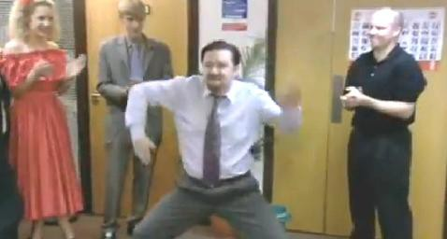
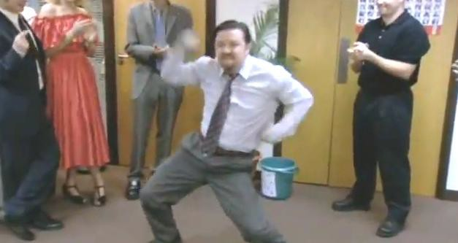
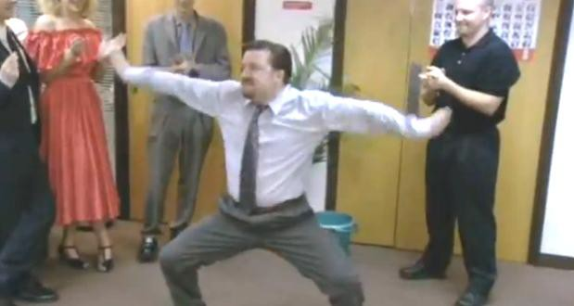
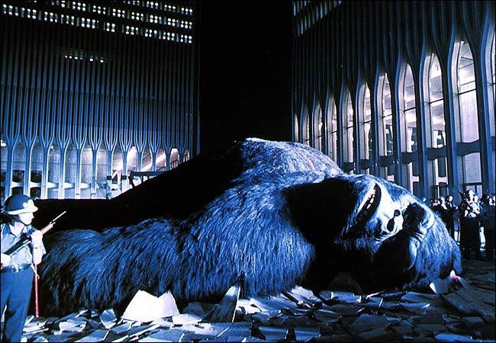
What is grammatical aspect?
The semantics of events
Nick Riches
Grammatical aspect refers to grammatical devices to signal one’s perpsective on an event.
Tense
What is tense? A future tense?
Lexical Aspect
Inherent temporal properties of events
States versus non-states
Activities versus events
Accomplishments versus achievements
Lexical Aspect Table Summary of tests Multiple lexical aspects
Grammatical aspect
What is grammatical aspect?
David Brent is dancing.
Progressive aspect shows we are still inside the event (it is not finished)
Tense is not aspect
Tense & Aspect combinations
Pres. tense combs. Prog. asp. combs.
King Kong has fallen Perfective aspect shows we are
outside the event
Tense/aspect and SLT practice
(it is finished)
Homework
Bibliography
27 / 38

Slide 41
The semantics of events
Nick Riches
Tense
Lexical Aspect
Tense
What is tense? A future tense?
Lexical Aspect
Inherent temporal properties of events
States versus non-states
Activities versus events
Accomplishments versus achievements
Lexical Aspect Table Summary of tests Multiple lexical aspects
Grammatical aspect
Tense is not aspect
Combinations of tense, grammatical and lexical aspect
Grammatical aspect
What is grammatical aspect?
Tense/aspect and SLT practice
Homework
Tense is not aspect
Tense & Aspect combinations
Pres. tense combs.
Bibliography
Prog. asp. combs.
Tense/aspect and
SLT practice
Homework
Bibliography
27 / 38

Slide 42
The semantics of events
Nick Riches
Tense
What is tense? A future tense?
Lexical Aspect
Inherent temporal properties of events
States versus non-states
Activities versus events
Accomplishments versus achievements
Lexical Aspect Table Summary of tests Multiple lexical aspects
‘tense’
Aspect
By this time next week, I will have eaten all of the tins of baked beans in my cupboard
She was sleeping when the earthquake happened
Grammatical aspect
What is grammatical aspect?
tense
Aspect
Tense is not aspect
Tense & Aspect combinations
Pres. tense combs.
Prog. asp. combs.
Tense/aspect and
SLT practice
Homework
Bibliography
28 / 38

Slide 43
The semantics of events
Nick Riches
Tense
Lexical Aspect
Tense
What is tense? A future tense?
Lexical Aspect
Inherent temporal properties of events
States versus non-states
Activities versus events
Accomplishments versus achievements
Lexical Aspect Table Summary of tests Multiple lexical aspects
Grammatical aspect
Tense is not aspect
Combinations of tense, grammatical and lexical aspect
Grammatical aspect
What is grammatical aspect?
Tense/aspect and SLT practice
Homework
Tense is not aspect
Tense & Aspect combinations
Pres. tense combs.
Bibliography
Prog. asp. combs.
Tense/aspect and
SLT practice
Homework
Bibliography
28 / 38

Slide 44
The semantics of events
Nick Riches
Tense
What is tense? A future tense?
Lexical Aspect
Inherent temporal properties of events
States versus non-states
Activities versus events
Accomplishments versus achievements
Lexical Aspect Table Summary of tests Multiple lexical aspects
Lexical and grammatical aspect are closely ‘aligned’
Activity verbs + progressive grammatical aspect
The horse is running
Accomplishment/achievement verbs + perfective grammatical aspect
He has just jumped off the roof
She has reached the top of the mountain
Grammatical aspect
What is grammatical aspect?
Tense is not aspect
Tense & Aspect combinations
Pres. tense combs.
Prog. asp. combs.
Tense/aspect and
SLT practice
Homework
Bibliography
29 / 38

Slide 45
(a) Present tense and Activity/Accomplishment/Achievement verbs
The semantics of events
Nick Riches
Tense
What is tense? A future tense?
Lexical Aspect
Inherent temporal properties of events
States versus non-states
Activities versus events
Accomplishments versus achievements
Lexical Aspect Table Summary of tests Multiple lexical aspects
She sings every day.
He works in a call centre
He smashes things (he’s clumsy or aggressive)
Grammatical aspect
What is grammatical aspect?
Tense is not aspect
Tense & Aspect combinations
Pres. tense combs. Prog. asp. combs.
Tense/aspect and SLT practice
Homework Bibliography
30 / 38

Slide 46
(a) Present tense and Activity/Accomplishment/Achievement verbs
The semantics of events
Nick Riches
Tense
What is tense? A future tense?
Lexical Aspect
Inherent temporal properties of events
States versus non-states
Activities versus events
Accomplishments versus achievements
Lexical Aspect Table Summary of tests Multiple lexical aspects
She sings every day.
He works in a call centre
He smashes things (he’s clumsy or aggressive)
Grammatical aspect
What is grammatical aspect?
A habitual interpretation
Tense is not aspect
Tense & Aspect combinations
Pres. tense combs.
Prog. asp. combs.
Tense/aspect and
SLT practice
Homework
Bibliography
30 / 38

Slide 47
(b) Progressive grammatical aspect and achievement verbs
The semantics of events
Nick Riches
Tense
What is tense? A future tense?
Lexical Aspect
Inherent temporal properties of events
States versus non-states
Activities versus events
Accomplishments versus achievements
Lexical Aspect Table Summary of tests Multiple lexical aspects
The light is flashing
He’s flattening boxes
Grammatical aspect
What is grammatical aspect?
Tense is not aspect
Tense & Aspect combinations
Pres. tense combs.
Prog. asp. combs.
Tense/aspect and
SLT practice
Homework
Bibliography
31 / 38

Slide 48
(b) Progressive grammatical aspect and achievement verbs
The semantics of events
Nick Riches
Tense
What is tense? A future tense?
Lexical Aspect
Inherent temporal properties of events
States versus non-states
Activities versus events
Accomplishments versus achievements
Lexical Aspect Table Summary of tests Multiple lexical aspects
The light is flashing
He’s flattening boxes
An iterative interpretation (NB achievement becomes accomplishment)
Grammatical aspect
What is grammatical aspect?
Tense is not aspect
Tense & Aspect combinations
Pres. tense combs.
Prog. asp. combs.
Tense/aspect and
SLT practice
Homework
Bibliography
31 / 38

Slide 49
The semantics of events
Nick Riches
Tense
Lexical Aspect
Tense
What is tense? A future tense?
Lexical Aspect
Inherent temporal properties of events
States versus non-states
Activities versus events
Accomplishments versus achievements
Lexical Aspect Table Summary of tests Multiple lexical aspects
Grammatical aspect
Tense is not aspect
Combinations of tense, grammatical and lexical aspect
Grammatical aspect
What is grammatical aspect?
Tense/aspect and SLT practice
Homework
Tense is not aspect
Tense & Aspect combinations
Pres. tense combs.
Bibliography
Prog. asp. combs.
Tense/aspect and
SLT practice
Homework
Bibliography
31 / 38

Slide 50
The semantics of events
Nick Riches
Tense
What is tense? A future tense?
Lexical Aspect
Inherent temporal properties of events
States versus non-states
Activities versus events
Accomplishments versus achievements
Lexical Aspect Table Summary of tests Multiple lexical aspects
Children with SLI have difficulties marking tense, e.g.
1. He went there ⇒ Him go there
Morphological or conceptual difficulty?
Grammatical aspect
What is grammatical aspect?
Tense is not aspect
Tense & Aspect
combinations
Pres. tense combs. Prog. asp. combs.
Tense/aspect and
SLT practice
Homework
Bibliography
32 / 38

Slide 51
The semantics of events
Nick Riches
Tense
What is tense? A future tense?
Lexical Aspect
Inherent temporal properties of events
States versus non-states
Activities versus events
Accomplishments versus achievements
Lexical Aspect Table Summary of tests Multiple lexical aspects
Young children, when acquiring tense, conflate tense and lexical aspect.
They are more likely to mark past tense on Achievement and Accomplishment verbs, because these tend to describe COMPLETED events.
e.g. Van Horne et al. 2017; Johnson & Morris, 2007. Can we manipulate lexical aspect when teaching tense
Grammatical aspect
What is grammatical aspect?
Tense is not aspect
endings?
Tense & Aspect
combinations
Pres. tense combs. Prog. asp. combs.
Tense/aspect and
SLT practice
Homework
Bibliography
33 / 38

Slide 52
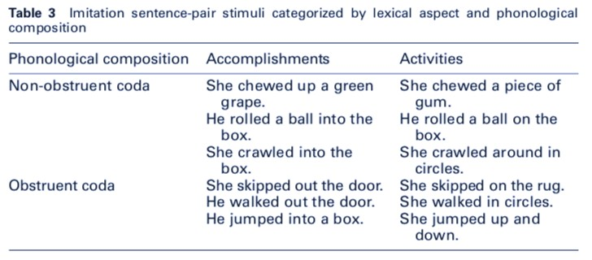
The semantics of events
Nick Riches
Johnson & Morris design
Tense
What is tense? A future tense?
Lexical Aspect
Inherent temporal properties of events
States versus non-states
Activities versus events
Accomplishments versus achievements
Lexical Aspect Table Summary of tests Multiple lexical aspects
Grammatical aspect
What is grammatical aspect?
Tense is not aspect
Tense & Aspect combinations
Pres. tense combs. Prog. asp. combs.
Tense/aspect and SLT practice
Homework Bibliography
34 / 38

Slide 53
The semantics of events
Nick Riches
Tense
What is tense? A future tense?
Lexical Aspect
Inherent temporal properties of events
States versus non-states
Activities versus events
Accomplishments versus achievements
Lexical Aspect Table Summary of tests Multiple lexical aspects
Van Horne et al. 2017 - found that children with DLD learnt to produce the past tense better when both aspectual and phonological properties of a verb rendered it more difficult!!
Grammatical aspect
What is grammatical aspect?
Tense is not aspect
Tense & Aspect combinations
Pres. tense combs.
Prog. asp. combs.
Tense/aspect and
SLT practice
Homework
Bibliography
35 / 38

Slide 54
The semantics of events
Nick Riches
Tense
Lexical Aspect
Tense
What is tense? A future tense?
Lexical Aspect
Inherent temporal properties of events
States versus non-states
Activities versus events
Accomplishments versus achievements
Lexical Aspect Table Summary of tests Multiple lexical aspects
Grammatical aspect
Tense is not aspect
Combinations of tense, grammatical and lexical aspect
Grammatical aspect
What is grammatical aspect?
Tense/aspect and SLT practice
Homework
Tense is not aspect
Tense & Aspect combinations
Pres. tense combs.
Bibliography
Prog. asp. combs.
Tense/aspect and
SLT practice
Homework
Bibliography
35 / 38

Slide 55
The semantics of events
Nick Riches
Tense
What is tense? A future tense?
Lexical Aspect
Inherent temporal properties of events
States versus non-states
Activities versus events
Accomplishments versus achievements
Lexical Aspect Table Summary of tests Multiple lexical aspects
What is unusual about the following sentence? “Here be dragons”
Grammatical aspect
What is grammatical aspect?
Tense is not aspect
Tense & Aspect combinations
Pres. tense combs.
Prog. asp. combs.
Tense/aspect and
SLT practice
Homework
Bibliography
36 / 38

Slide 56
The semantics of events
Nick Riches
Tense
Lexical Aspect
Tense
What is tense? A future tense?
Lexical Aspect
Inherent temporal properties of events
States versus non-states
Activities versus events
Accomplishments versus achievements
Lexical Aspect Table Summary of tests Multiple lexical aspects
Grammatical aspect
Tense is not aspect
Combinations of tense, grammatical and lexical aspect
Grammatical aspect
What is grammatical aspect?
Tense/aspect and SLT practice
Homework
Tense is not aspect
Tense & Aspect combinations
Pres. tense combs.
Bibliography
Prog. asp. combs.
Tense/aspect and
SLT practice
Homework
Bibliography
36 / 38

Slide 57
The semantics of events
Nick Riches
Tense
What is tense? A future tense?
Intervention studies looking at tense / aspect:
Van Horne, A. J. O., Fey, M., & Curran, M. (2017). Do the Hard Things First: A Randomized Controlled Trial Testing the Effects of Exemplar Selection on Generalization Following Therapy for Grammatical Morphology. Journal of Speech Language and Hearing Research, 60 (9), 2569; Johnson, B. W.
Morris, S. R. (2007). Clinical implications of the effects of lexical aspect and phonology on children’s production of the regular past tense. Child Language Teaching and Therapy, 23 (3), 287–306.)
Lexical Aspect
Inherent temporal properties of events
States versus non-states
Activities versus events
Accomplishments versus achievements
Lexical Aspect Table Summary of tests Multiple lexical aspects
Grammatical aspect
What is grammatical aspect?
Tense is not aspect
Tense & Aspect combinations
Pres. tense combs. Prog. asp. combs.
Tense/aspect and
SLT practice
Homework
Bibliography
37 / 38

Slide 58
The semantics of events
Nick Riches
Tense
What is tense? A future tense?
Studies on aspect in language-impaired children
Fletcher, P., Leonard, L. B., Stokes, S. F., & Wong, A. M.
Y. (2005). The expression of aspect in Cantonese-speaking children with Specific Language Impairment. Journal of Speech Language and Hearing Research, 48 (3)
Leonard, L. B., Deevy, P., Kurtz, R., Krantz Chorev, L., Owen, A., Polite, E., Finneran, D. (2007). Lexical aspect and the use of verb morphology by children with specific language impairment. Journal of Speech, Language, and Hearing Research, 50 (3), 759.)
Lexical Aspect
Inherent temporal properties of events
States versus non-states
Activities versus events
Accomplishments versus achievements
Lexical Aspect Table Summary of tests Multiple lexical aspects
Grammatical aspect
What is grammatical aspect?
Tense is not aspect
Tense & Aspect combinations
Pres. tense combs.
Prog. asp. combs.
Tense/aspect and
SLT practice
Homework
Bibliography
38 / 38

